Slide 1
Computing Functions with
Turing Machines
Costas Busch - LSU

Slide 2
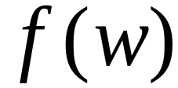


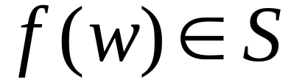

A function
has:
Domain:
Result Region:
Costas Busch - LSU

Slide 3
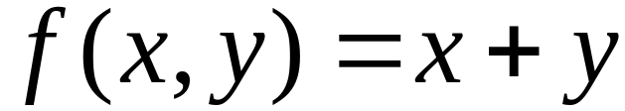
A function may have many parameters:
Example:
Addition function
Costas Busch - LSU

Slide 4
Integer Domain
Decimal:
5
Binary:
101
Unary:
11111
We prefer unary representation:
easier to manipulate with Turing machines
Costas Busch - LSU

Slide 5



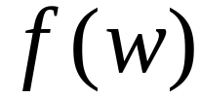


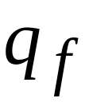
Definition:
A function is computable if
there is a Turing Machine such that:
Initial configuration
Final configuration
initial state
accept state
For all
Domain
Costas Busch - LSU

Slide 6
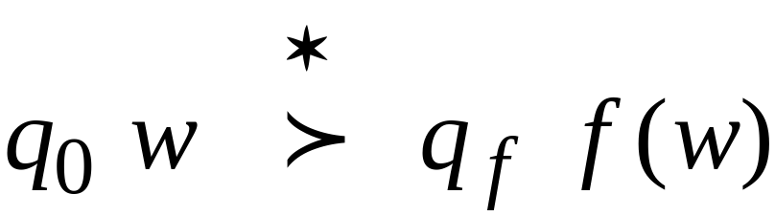
In other words:
A function is computable if
there is a Turing Machine such that:
Initial
Configuration
Final
Configuration
For all
Domain
Costas Busch - LSU

Slide 7

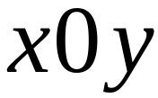
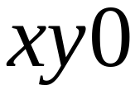
Example
The function
is computable
are integers
Turing Machine:
Input string:
unary
Output string:
unary
Costas Busch - LSU

Slide 8




Start
initial state
The 0 is the delimiter that
separates the two numbers
Costas Busch - LSU

Slide 9

Start
initial state
Finish
final state
Costas Busch - LSU

Slide 10
The 0 here helps when we use
the result for other operations
Finish
final state
Costas Busch - LSU

Slide 11










Turing machine for function
Costas Busch - LSU

Slide 12

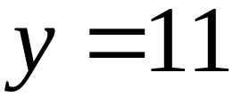
Execution Example:
Time 0
(=2)
(=2)
Final Result
Costas Busch - LSU

Slide 13
Time 0
Costas Busch - LSU

Slide 14
Time 1
Costas Busch - LSU

Slide 15
Time 2
Costas Busch - LSU

Slide 16
Time 3
Costas Busch - LSU

Slide 17
Time 4
Costas Busch - LSU

Slide 18
Time 5
Costas Busch - LSU

Slide 19
Time 6
Costas Busch - LSU

Slide 20
Time 7
Costas Busch - LSU

Slide 21
Time 8
Costas Busch - LSU

Slide 22
Time 9
Costas Busch - LSU

Slide 23
Time 10
Costas Busch - LSU

Slide 24
Time 11
Costas Busch - LSU

Slide 25
Time 12
HALT & accept
Costas Busch - LSU

Slide 26
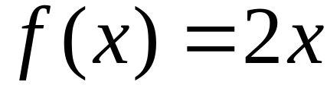

Another Example
The function
is computable
is integer
Turing Machine:
Input string:
unary
Output string:
unary
Costas Busch - LSU

Slide 27

Start
initial state
Finish
accept state
Costas Busch - LSU

Slide 28
Turing Machine Pseudocode for
Replace every 1 with $
Repeat:
Find rightmost $, replace it with 1
Go to right end, insert 1
Until no more $ remain
Costas Busch - LSU

Slide 29
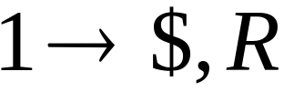
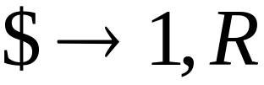

Turing Machine for
Costas Busch - LSU

Slide 30
Example
Start
Finish
Costas Busch - LSU

Slide 31


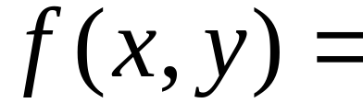

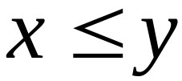
Another Example
if
The function
is computable
if
Input:
Output:
or
Costas Busch - LSU

Slide 32
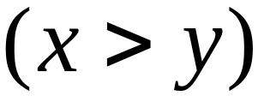
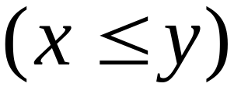
Turing Machine Pseudocode:
Repeat
Match a 1 from with a 1 from
Until all of or is matched
If a 1 from is not matched
erase tape, write 1
else
erase tape, write 0
Costas Busch - LSU

Slide 33
Combining Turing Machines
Costas Busch - LSU

Slide 34
Block Diagram
Turing
Machine
input
output
Costas Busch - LSU

Slide 35


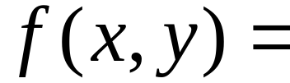


Example:
if
if
Adder
Comparator
Eraser
Costas Busch - LSU

